Slide 1

Hotel Aggregator Listing Analysis
Nneamaka.R.Ukwajiunor

Slide 2

Objective
The aim of the projects is to create a comprehensive visualization and gain insight into the trend,
patterns and factors influencing the performance of listing.

Slide 3
Problem Statement
Questions to be answered to gain more insight;
Geographical Insight
What are the popular neighborhood by listing distribution
Idenify listing concentration by host locations.
Pricing and Availabity Analyses
Analyse pricing trend base on room and property type, accommodation capacity
What is the availability of listing over time,
Identify peak period.

Slide 4
Problem Statement
Host Performance
Evaluate characteristics, super host status , responds time and verification method
What is the correlation of between host attribute and list performanc
4. What is the score review by guest satisfaction
5.Wat is the review score by listing performance
6. Analyse the distribution of property type and room type

Slide 5
Context
The hotel aggregator listing dataset has 23,185 listings in various countries and cities. The data includes Information about hosts, pricing, location and room type and many review score.
The following were carried out on the data
Extraction, Transform and loading of the data
Creation of Multiple Interractive Charts
Implentation of Filter, Slicer, Conditional formatting
Dax formulas
Visualization

Slide 6
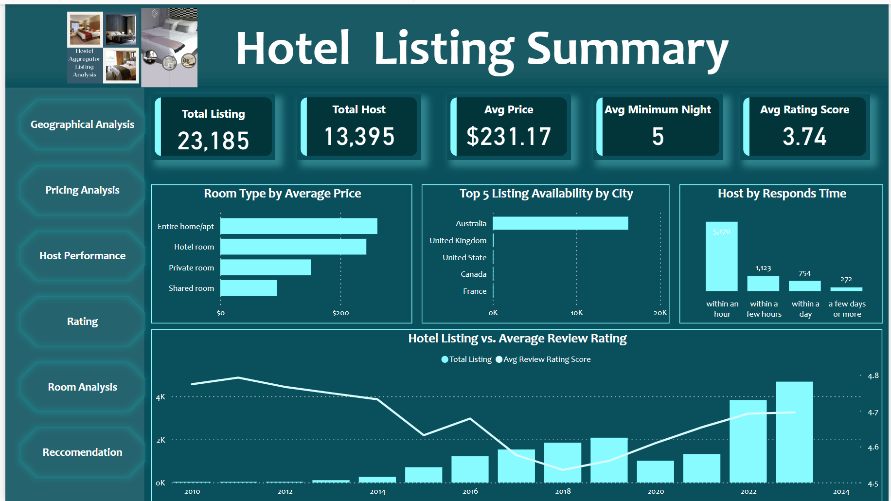
Insight
The analysis Indicates
A consistent uptrend in hotel listing overtime, accompanied by an increase in average review scores from 20118 to 2023
Among the four different room type available for listing, Entire room apartments commands the highest price.
Australia emerges as the leading country in the number of listing among the top 5
While majority of the host responds with an hour, ensuring prompts and efficient guest satisfaction.

Slide 7
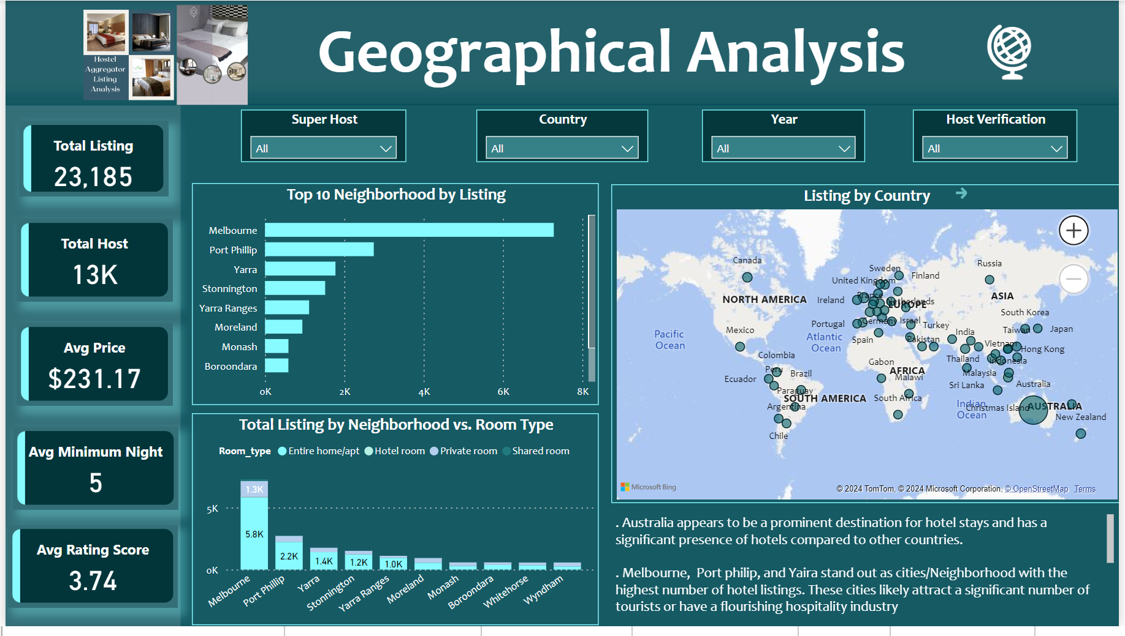
Insight
The analysis Indicates
Australia appears to be a prominent destination for hotel stays and has a significant presence of hotels compared to other countries.
Melbourne, Port philip, and Yara stand out as cities/Neighborhood with the highest number of hotel listings. These cities likely attract a significant number of tourists or have a flourishing hospitality industry
.Certain neighborhoods specialize in specific room types, with majority dominated by 'entire home apartment' room types. This indicates specialization in accommodation offerings, catering to various preferences or demands of visitors.
In essence, the insights shed light on the distribution and popularity of hotel listings across countries, cities, and neighborhoods, offering valuable information for stakeholders in the hospitality industry and travelers alike.

Slide 8
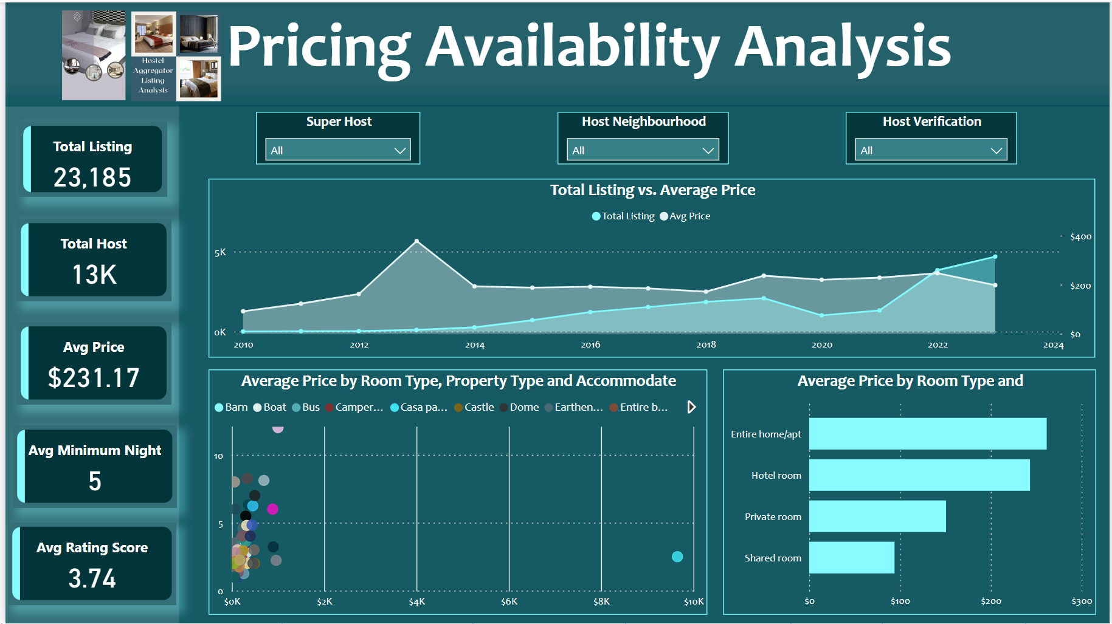
Insight
The analysis Indicates
Market Trends: The overall trend indicates increasing competition and a decrease in average prices as the market becomes saturated with more listings.
Room Type and Pricing: "Entire home" listings, especially unique property types like "villa" and "loft," command higher prices and accommodate more guests, targeting a specific market segment. Meanwhile, the bulk of the market remains affordable and geared towards smaller accommodations.
Strategic Focus: For stakeholders, focusing on unique and premium offerings (like entire homes and specific property types) can be lucrative, though there is also substantial market potential in affordable, smaller accommodations given their prevalence and pricing stability

Slide 9
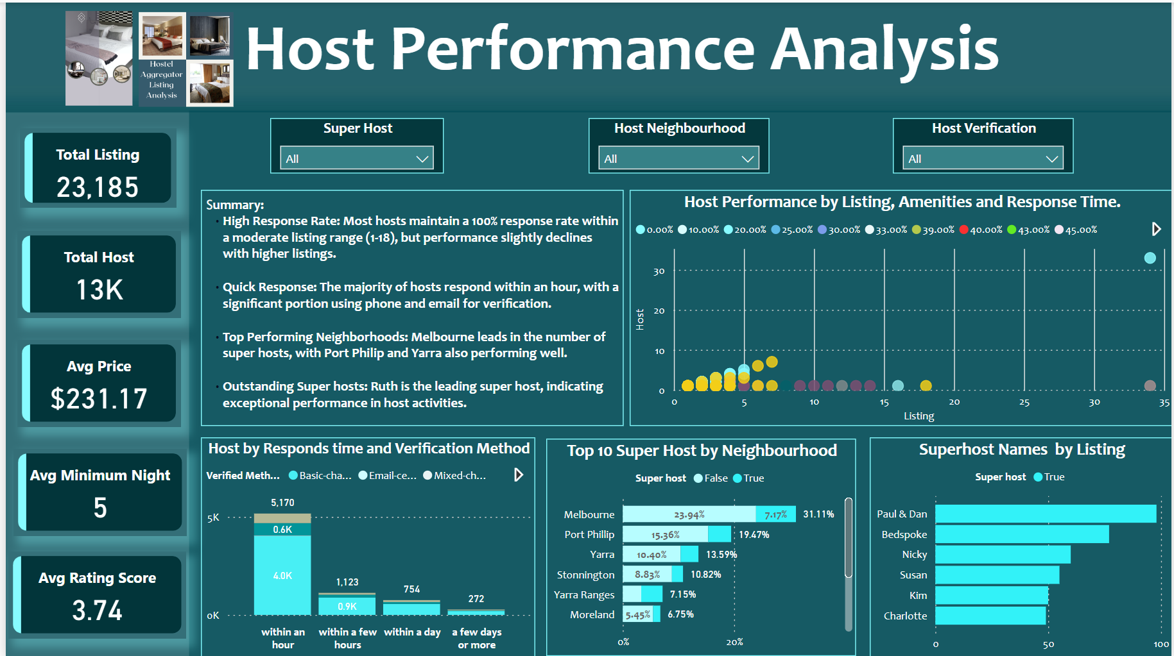
Insight
Summary:
High Response Rate: Most hosts maintain a 100% response rate within a moderate listing range (1-18), but performance slightly declines with higher listings.
Quick Response: The majority of hosts respond within an hour, with a significant portion using phone and email for verification.
Top Performing Neighborhoods: Melbourne leads in the number of super hosts, with Port Philip and Yarra also performing well
Outstanding Super hosts: Paul and Dan is the leading super host, indicating exceptional performance in host activities.

Slide 10
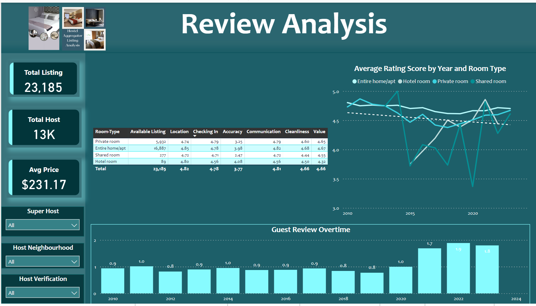
Insight
Overall Impact on Listing Performance:
The fall and subsequent rise in ratings for shared and hotel rooms suggest these categories faced challenges but have made improvements, likely impacting their attractiveness and booking rates positively in recent years.
The high and stable ratings for entire and private rooms likely contribute to their sustained high performance and preference among guests.
The increase in guest reviews from 2020 onwards indicates growing customer engagement and potentially higher occupancy rates, which can positively influence overall listing performance.

Slide 11
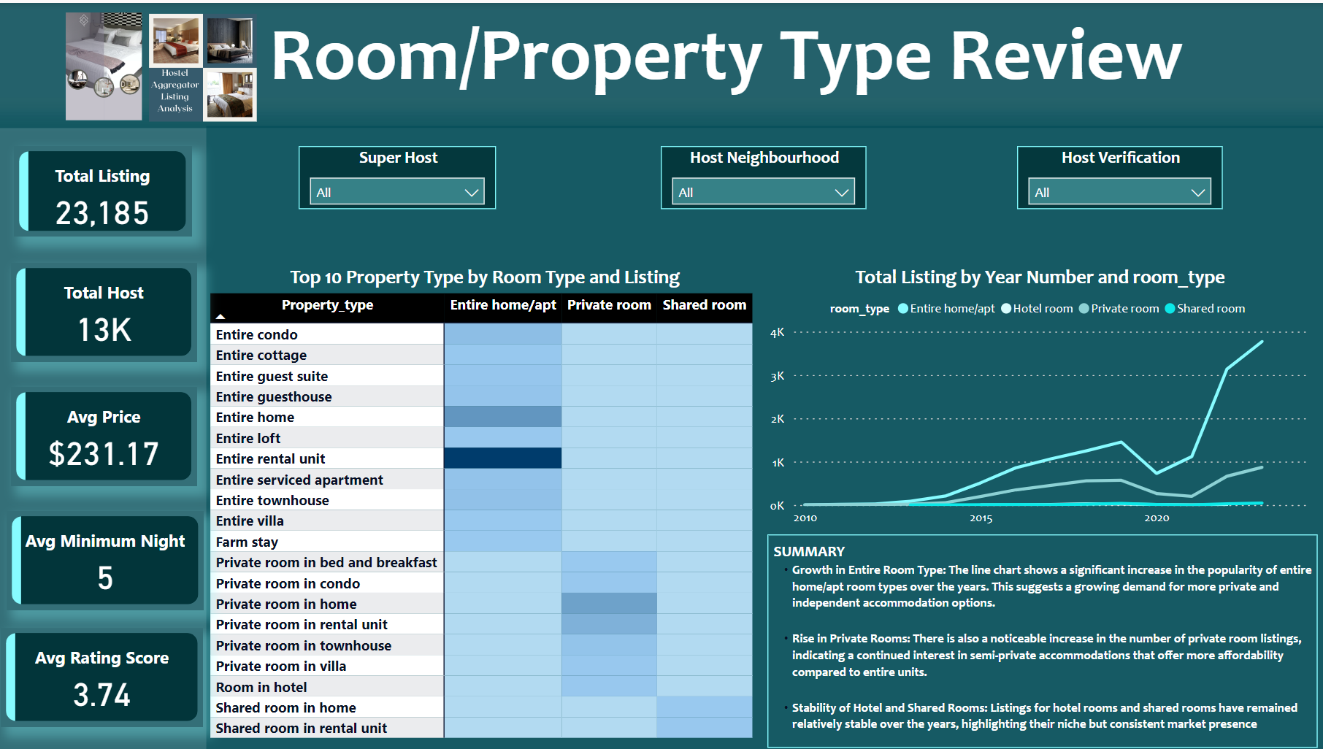
Insight
SUMMARY
Growth in Entire Room Type: The line chart shows a significant increase in the popularity of entire home/apt room types over the years. This suggests a growing demand for more private and independent accommodation options.
Rise in Private Rooms: There is also a noticeable increase in the number of private room listings, indicating a continued interest in semi-private accommodations that offer more affordability compared to entire units.
Stability of Hotel and Shared Rooms: Listings for hotel rooms and shared rooms have remained relatively stable over the years, highlighting their niche but consistent market presence

Slide 12
RECOMMENDATION
Hotel Aggregators should expand and promote high-demand hotel listings in Australia, especially in Melbourne, Port Phillip, and Yarra, to leverage their thriving hospitality markets. By emphasizing entire home apartments in popular neighborhoods, we can meet visitor preferences and drive more bookings.
Host should Aacquiring premium properties like entire homes, villas, and lofts will allow catering to higher-paying guests and larger groups, boosting revenue potential. Implementing dynamic pricing will ensure rates remain competitive and responsive to market demand.
Enhancing host verification processes will build trust and reliability across our platform.
Maintaining high standards for listings, addressing past issues, and encouraging guest reviews will further enhance hotel aggregators service quality and guest engagement.
By focusing on increasing listings for entire homes/apartments and private rooms, while stabilizing our inventory of hotel and shared rooms, align with market trends and visitor preferences.

Slide 13
THANKS

